Slide 1

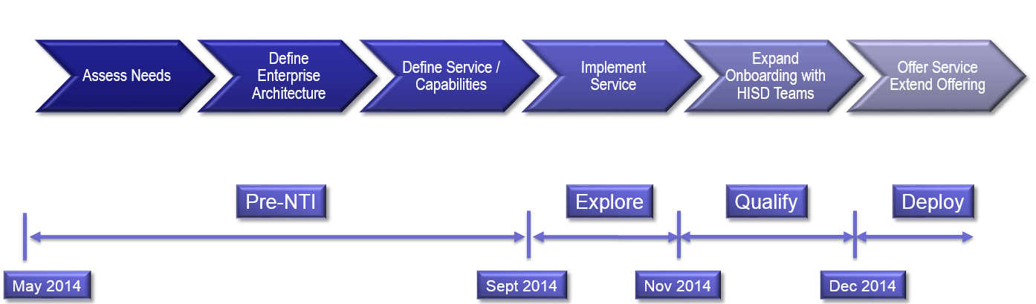
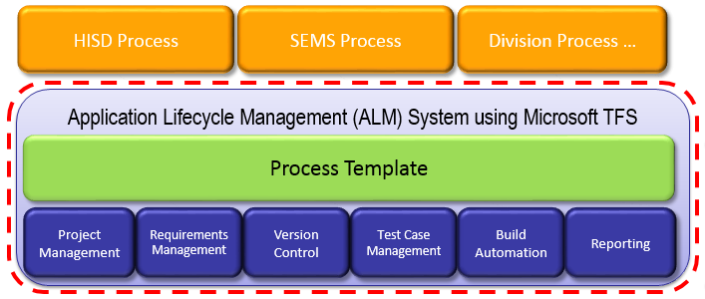
Enterprise Team Foundation Server (NTI)
Businesses – HIS, DOC, Unitek, AAD, IPD, TSSD, SOSD
Technology:
Establish an Application Lifecycle Management (ALM) Support System by leveraging Microsoft Team Foundation Server (TFS).
Objective:
Implement an Enterprise Team Foundation Server providing
Develop team of ALM specialists to support 3M software businesses
Status:
Pre-NTI
Progress:
System Requirements defined and accepted by multiple divisions
Multiple Divisions engaged – HIS, DOC, IPD, TSSD
Service Level Agreement Complete
System Architecture
Cost of Service Complete
HIS Team onboarding (ongoing)
Timeline
Project Management | Test Case Management
Requirements Management | Build Automation
Version Control | Reporting
Key SEMS Contacts: Mike O’Brien
Notes:
Built upon Nonwovens Modeling NTI to generate nonwoven filter construction
Developed modeling methology to characterize composite filter performance
Yielded insight into particle capture mechanism and efficiency
Demonstrated promising correlation for electrostatic filtration

